Slide 1
ENGI 301 Air Quality Data System Proposal
14 October 2021
Samuel Xu

Slide 2
Background Information
What is being proposed?
Pictures
Links to existing projects / libraries
What improvements / additions over existing project
What is your story?

Slide 3
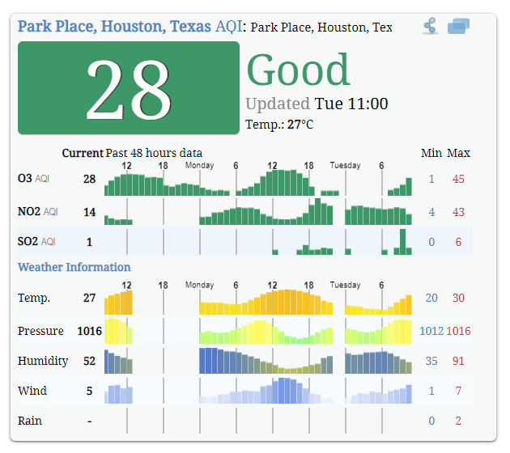
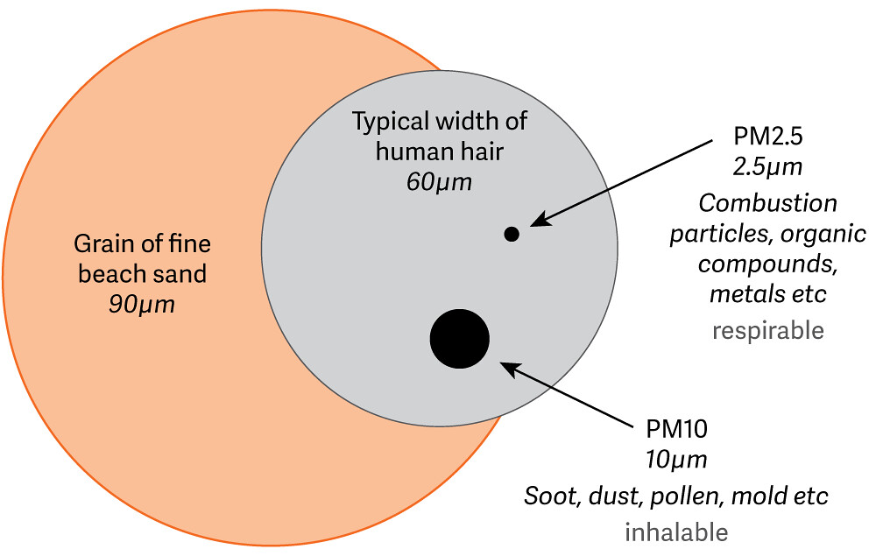
Background Information
Air quality data collection system:
PM2.5 / PM10
Humidity
Temperature
Store data
Upload to some sort of cloud host (details pending)
https://aqicn.org/city/texas/houston/park-place/
https://live.staticflickr.com/281/32205962052_3cf542db80_b.jpg

Slide 4
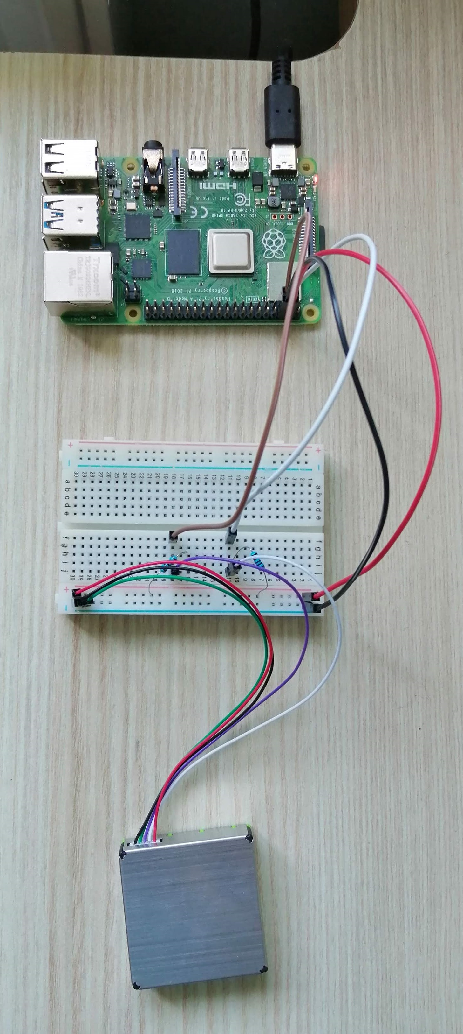
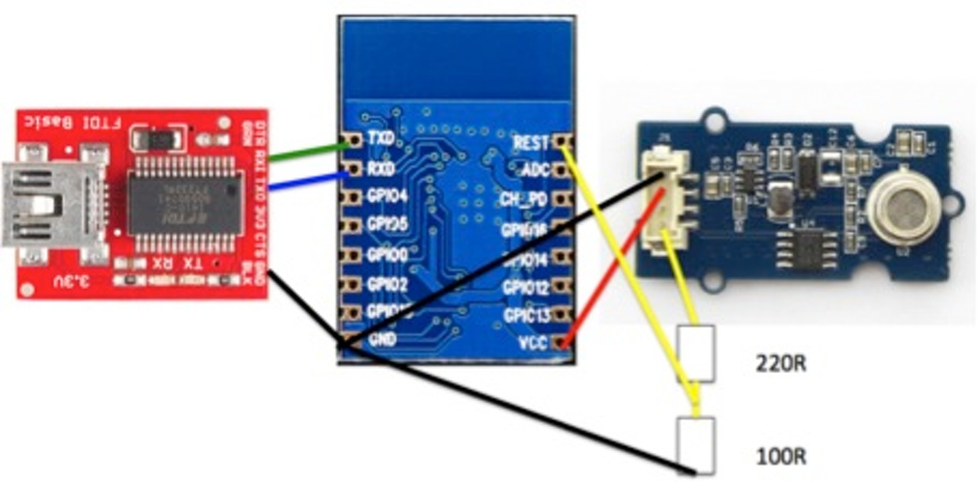
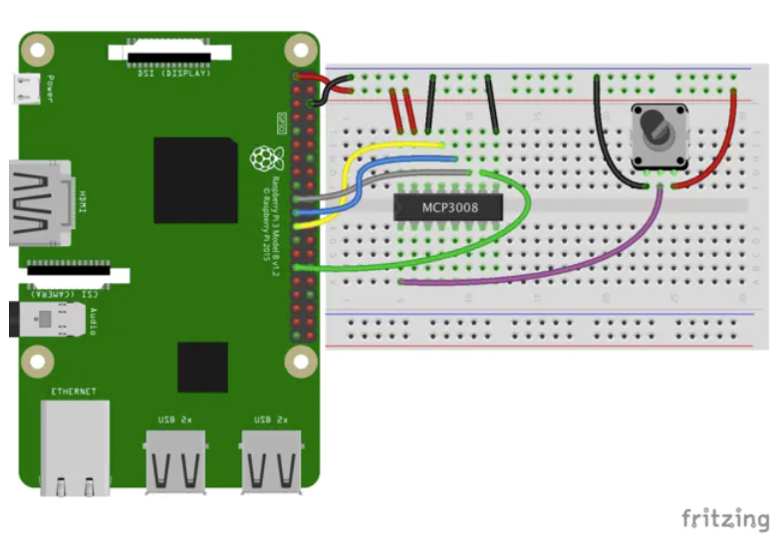
Background Information
Similar Projects:
Arduino Implementation
By 윤원호, Parkmoonsu, gledel, 정다연
ESP8266 implementation
By fab-lab.eu
By Art Arkhan
Raspberry Pi implementation
By David Gherghita, Ioan Herisanu
By Kutluhan Aktar
https://hackster.imgix.net/uploads/attachments/1205027/circuit_49jn5Pyi2K.jpg
https://hackster.imgix.net/uploads/image_file/file/66609/ESP8266_w2.jpg
https://hackster.imgix.net/uploads/attachments/1092040/connection_hqj846ivS8.png?auto=compress%2Cformat&w=740&h=555&fit=max

Slide 5
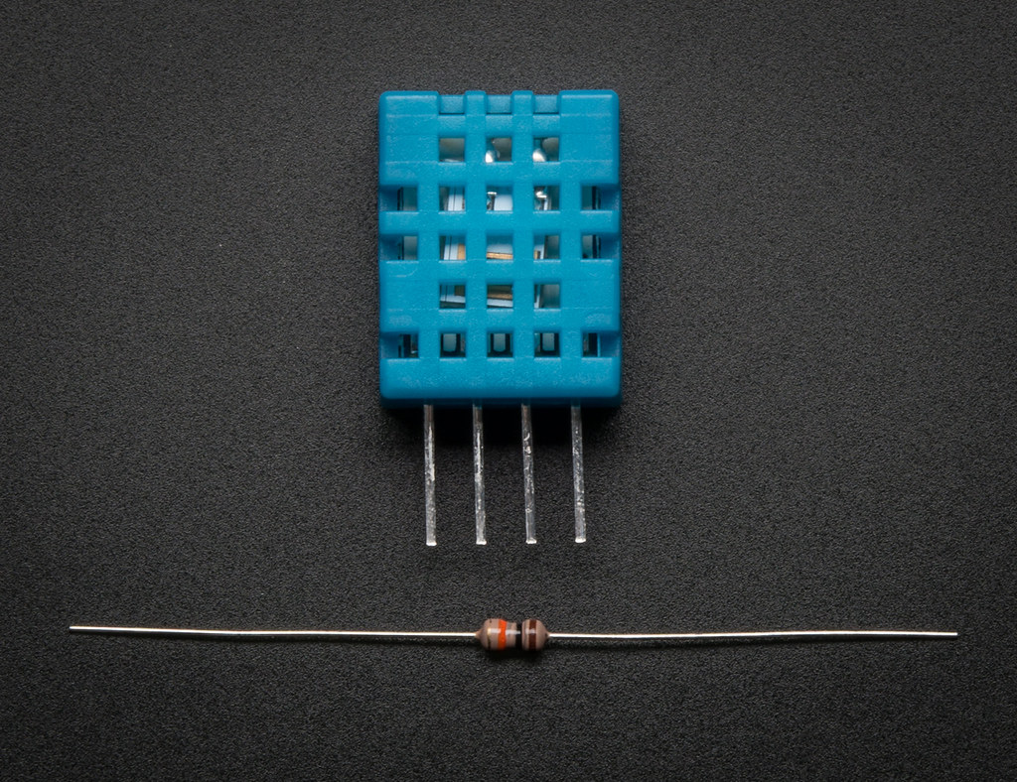
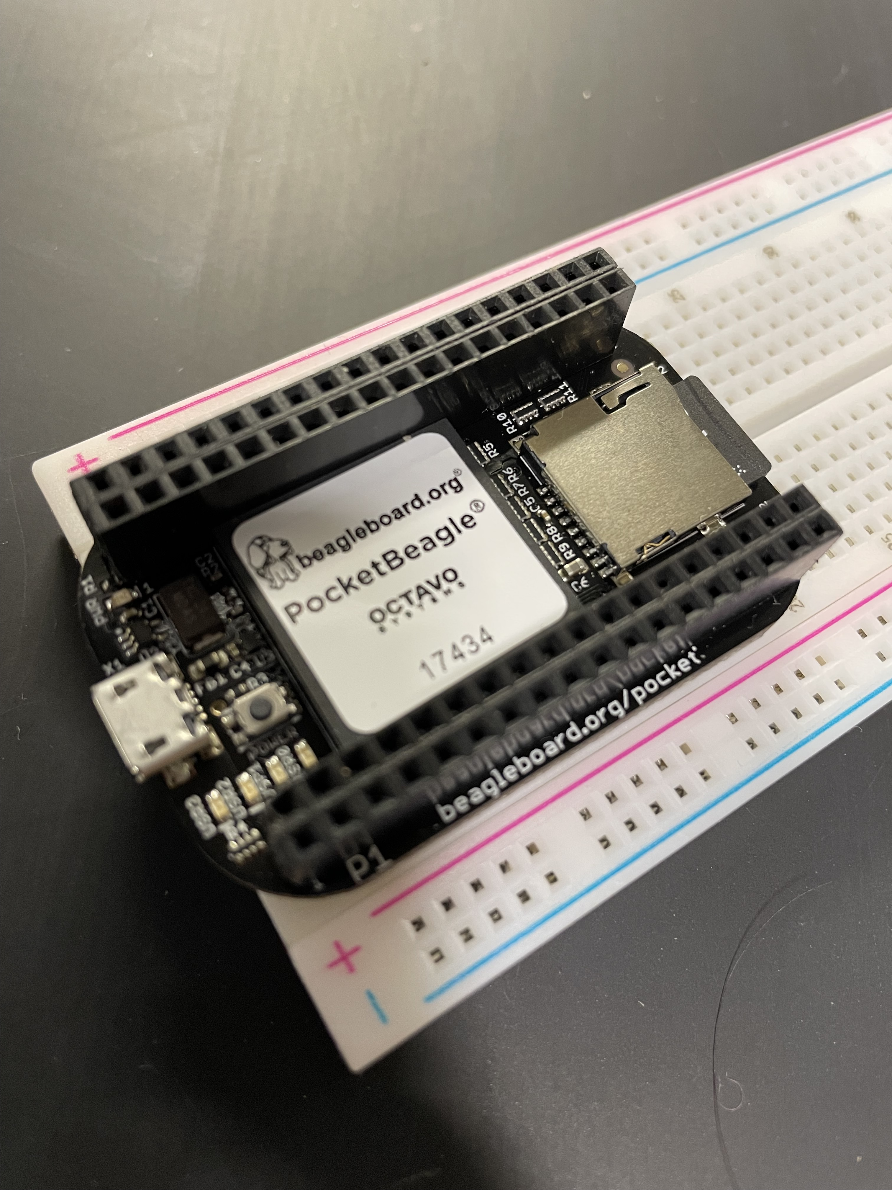
Background Information
How will this differ?
Addition of CO₂, humidity, temperature
Cost of sensors BeagleBone:
Vs. Rasp Pi, open-source hardware (BeagleBone)
Vs. ESP, 80-160 MHz vs. 1 GHz clock speed, 512 KiB – 4 MiB vs. 512 MB memory
https://live.staticflickr.com/5477/11211295045_c5fc143663_b.jpg

Slide 6
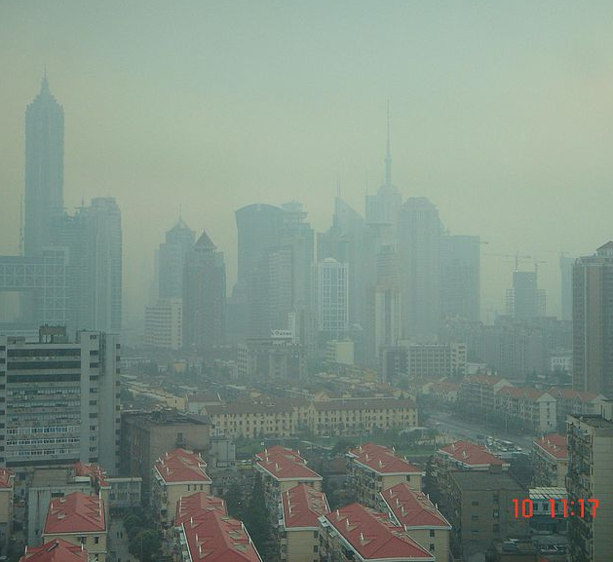
Background Information
The Story:
<- Shanghai
Keeping track of living environments
My high school friends a teacher:
Importance of sample size
Inspiration and my prior contributions
https://upload.wikimedia.org/wikipedia/commons/f/f6/Shanghai_Smog.JPG
Notes:
Extra details for this in the presenter notes here:
In the twelve years I’ve spent in Shanghai, air quality has always been somewhat of a constant concern. This was especially bad in the middle years of my stay, when numerous cities in China struggled with ‘the smog’. It was around 2013-2014 when I saw the most egregiously polluted days of my time. The reported air quality index shot was not just hazardous (avoid all physical or prolonged activity outdoors), but out of range (over 500), the smog had become so thick that it resembled fog, obscuring your vision beyond even 50 meters.
My mom became obsessed with buying second-hand air filters. My high school became similarly obsessed with blowing its budget on not just extensive filtration systems, but additional measures such as airlock-esque vestibules and sealing all the second floor walkways. As my friends and I got into high school, we started to see the problem as an opportunity to get involved. One of my closest friends began working on a scalable air quality sensing unit that he set up with a cloud service to measure air quality around the school. This was guided by one of my teachers who had taken the initiative to start teaching students about data science, and the scalability and cost of their project was a major factor. At one point, I was asked to help them design a 3D printable case for their parts and PCB. I did acknowledge that this wasn’t a wise choice for scaling their product, and they didn’t end up going with such a case.
The familiarity of this project, it’s ties to home, combined with the fact that my high school reserves most of the rights to my friend’s project (thereby leaving the opportunity open to make a parallel, open-source product), all led to me deciding to work on it.

Slide 7
System Block Diagram
Humidity & Temp (DHT11)
Display (2.2" 18-bit color TFT LCD)
CO₂ Sensor (CCS811)
5V Power Rail
PocketBeagle
Contains:
OSD3358
Dust Sensor (GP2Y1010AU0F)
Battery Connector
I2C0
USB Adaptor
Wifi Module
USB1
Not sure at this phase, may likely involve TX/RX
GPIO

Slide 8
Power Block Diagram
5V Power Rail
USB Connecting to outlet or power bank
PocketBeagle
Vin_BAT
3.3V Components:
(max indiv. 90 mA)
GP2Y1010AU0F
2.2" 18-bit color TFT LCD DHT11
CCS811 / SEN0339
3.3V
SYS_VDD1_3P3V
Micro-USB Connector
5V
Vin_USB

Slide 9
Component / Budget
Component | Need to Buy | Cost
PocketBeagle Rev A2 | No (given) | $25~
DHT11 Humidity & Temperature Sensor | No (in OEDK) | $4-10~
GP2Y1010AU0F Dust Sensor | Yes | $17.99
Breadboard | No (given) | $5~
CCS811 Air Quality Sensor (Breakout) / SEN0339 | Yes | $26.01
Wifi USB Module | No (will be given) | Variable
2.2" 18-bit color TFT LCD display | Yes | $24.95
GIVEN COST: $68.95 with the most expeditious shipping options
Need all components to be purchased by instructor listed; additional components may be purchased by student

Slide 10
Components / Budget
Component | Need to Buy | Link
GP2Y1010AU0F Dust Sensor | Yes | https://www.amazon.com/Waveshare-Dust-Sensor-GP2Y1010AU0F-Conditioner/dp/B07P94LCFZ/ref=pd_sbs_2/135-8217353-1077861?pd_rd_w=lYOrC&pf_rd_p=690958f6-2825-419e-9c16-73ffd4055b65&pf_rd_r=8JA20D3KJB8MKQVNNX3P&pd_rd_r=eaf4a4b9-b782-4072-9049-9ae419349734&pd_rd_wg=6ys1x&pd_rd_i=B07P94LCFZ&psc=1
CCS811 Air Quality Sensor (Breakout) / SEN0339 | Yes | https://www.amazon.com/Adafruit-CCS811-Quality-Sensor-Breakout/dp/B076PR2WKW
2.2" 18-bit color TFT LCD display | Yes | https://www.adafruit.com/product/1480
Need all components to be purchased by instructor listed; additional components may be purchased by student

